Slide 1

5G Network Slicing Simulation

Slide 2
Why 5G?
5G wireless networks are envisioned to meet the rising demand for network services from users. User devices have evolved and demand different services from the network. The user demands can be categorized based on latency, reliability and bandwidth required.

Slide 3
What slicing simulation aims to do?
5G widely defines network slicing concept which provides different and separate dedicated logical networks that can be customised to respective services.

Slide 4
Mobility Management
With the introduction of diverse 5G application scenarios, new mobility management schemes must be implemented in Sliced 5G networks in order to guarantee seamless handover between network slices. Mobility management allows users to move from one coverage area to another without losing network connection.

Slide 5
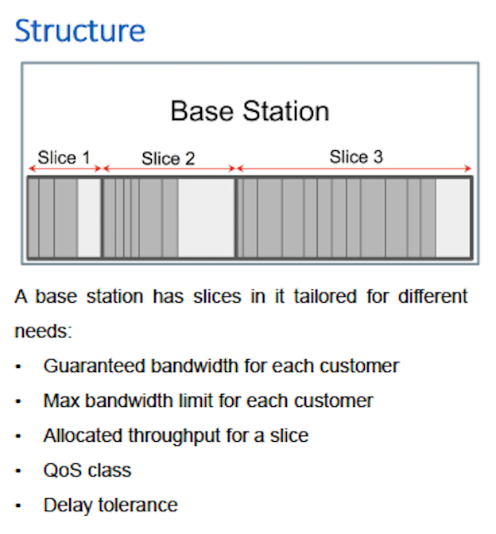

Slide 6
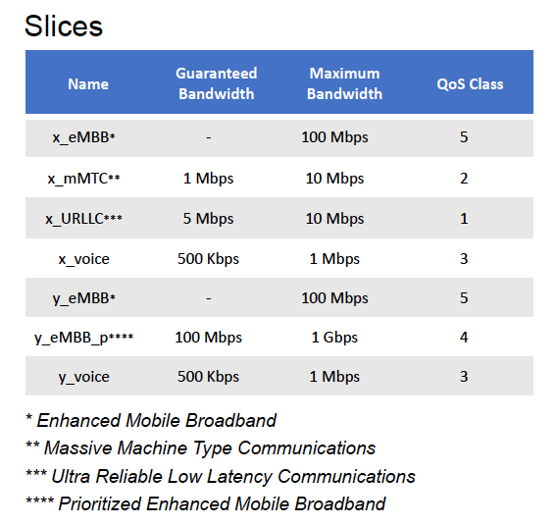

Slide 7
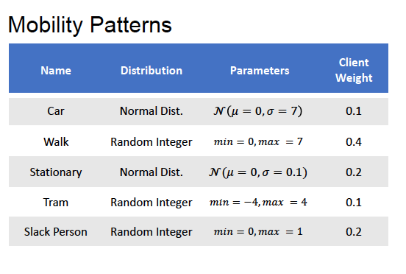

Slide 8
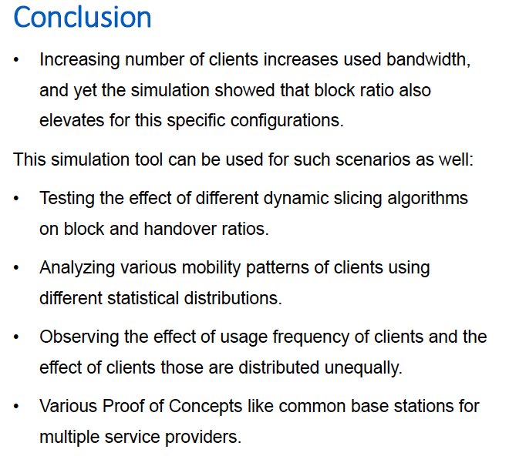

Slide 9
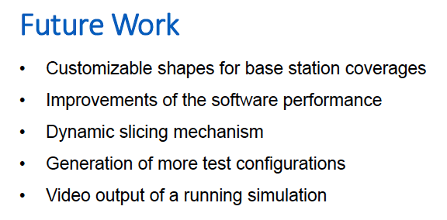

Slide 10
Thank You

